Slide 1
Identifying and Supporting Young Children with Disabilities in Early Education and Care Settings
Session 3: Supporting Young Children with Disabilities in Early Education and Care Settings

Slide 2
Session 3: Participant Outcomes
Participants will gain a general understanding of the characteristics exhibited by children diagnosed with common disabilities typically seen in Early Education and Care Settings.
Participants will be able to list specific behaviors associated with a disability they choose to research.
Participants will demonstrate how to read and use evaluations and other reports to develop support strategies in their setting.
Participants will plan general adaptations to their environment s in order to include children with disabilities in their settings.
Participants will be able to plan strategies to adapt curriculum to meet the needs of students with disabilities.

Slide 3
SpecialQuest Video
IEP’s Putting them into action. Please use the guided viewing sheet as a guide while you are watching this video.

Slide 4
IFSP’s, IEP’s and Evaluations
There is important information contained in each of these types of documents that will be helpful when supporting a child with a disability in your program.
Ask parents for copies of the evaluations, reports and service plans.
Get written permission to talk with the key therapists involved in supporting the child.
Look at the goals in the reports and think about how you can incorporate them into your program when planning for this child.

Slide 5
Individual Activity
Please read the following article “Have you seen my son Binny” using the guided reading questions as a guide.
Be prepared to share your answers with the large group.

Slide 6

Definition of Early Childhood Inclusion
Early childhood inclusion embodies the values, policies, and practices that support the right of every infant and young child and his or her family, regardless of ability, to participate in a broad range of activities and contexts as full members of families, communities, and society. The desired results of inclusive experiences for children with and without disabilities and their families include sense of belonging and membership, positive social relationships and friendships, and development and learning to reach their full potential. The defining features of inclusion that can be used to identify high quality early childhood programs and services are access, participation, and supports. ( excerpt from a Summary of the joint position stations of DEC and NAEYC )

Slide 7
Getting Started
This video is part of the specialquest learning library.
As you watch the video record what strategies the staff used to prepare for Jalissa. What type of additional equipment or training did the staff need. What issues did the staff face including a child with multiple issues?

Slide 8
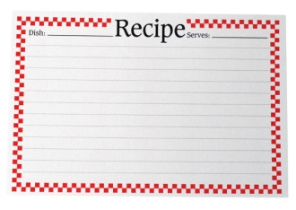
Recipe for Inclusion
What ingredients are needed for inclusion to be successful ?

Slide 9
Defining Factors for Inclusion
Access: Universal Design can be used to help children access various environments through the removal of physical and structural barriers. Universal Design for Learning reflects practices that provide multiple and varied formats for instruction and learning.
Participation: In addition to access some children will need individualized accommodations and supports to fully participate in the program. Implementing inclusion means employing a variety of practices from embedded, routine based teaching to explicit interventions that scaffold learning.
Supports: A support system must be in place to provide guidance and assistance to ensure that the staff has the tools they need to appropriate implement inclusion. This means ongoing professional development and collaboration between the specialists and other parties involved with the particular child.

Slide 10
Inclusion and the Law
Federal Laws: IDEA (Individuals with Disabilities Act) states that children ages 3-21 are entitles to a Free and Appropriate Public Education in the Least Restrictive Environment, which means children with disabilities should have access to the general curriculum along with learning activities and settings that are available to their peers without disabilities.
Massachusetts Law General Law 71B: This is the section of the law that contains Massachusetts implementation of the law. Young children with disabilities under three are provided support and services through Early Intervention programs managed by the Department of Public Health. Children over the age of three are provided support within the context of public Schools under the direction of the Department of Education.
The distinction between the two systems is the way they develop service plans. Early Intervention designs plan which look at the child in all environments. The Department of Education develops a plan which has a focus on the educational aspect only!

Slide 11
Benefits of Inclusion
Research has shown that inclusion benefits all children. Inclusive classrooms reach beyond academics. Here are some of the benefits of being part of an inclusive classroom:
Typically developing children:
Demonstrate an increased tolerance of and appreciation of diversity.
They develop better communication and social skills; and learn to create warm and caring friendships.
They show a greater development in moral or ethical principles.
Children with disabilities:
Are viewed as a child first, with special needs secondary
Learn social, coping, and problem solving skills; and becomes more self reliant and independent.
Children involved in inclusive setting grow up to be adults who are accepting of others.
(adapted from the article “Inclusion for Preschoolers” by Amy Kadell)

Slide 12
Individual activity: What Modifications are needed to include this child in your program?
Participants will be asked to use the Inclusion planning checklist to identify what is needed to include a child with the disability they researched for homework in their program. in their program.

Slide 13
Strategies for Inclusion
Explicit Child Focused Instructional Strategies
Embedded Learning Opportunities
Curriculum Modifications
and Adaptations
High Quality Early childhood Program
(from Building Blocks for Teaching Preschoolers with Special Needs by Susan Sandall and Ilene Schwartz.)

Slide 14
High Quality Early childhood Program
Think about your current program. Does it include the following elements?
Engaging interactions?
A responsive and predictable environment?
Many opportunities for learning?
Teaching that is matched for the child and the activity?
Developmentally appropriate material, activities, and interactions?
Safe, hygienic practices?
Appropriate levels of child guidance?
Meaningful involvement for families?

Slide 15
Curriculum Modifications and Adaptations
Curriculum modification is a change to ongoing classroom activities or materials to achieve or maximize a child’s participation. (from Building Blocks for Teaching Preschoolers with Special Needs by Susan Sandall and Ilene Schwartz.)
There are eight types of modifications/adaptations that can be easily implemented in Early childhood Setting to include young children with disabilities.
Environmental support Materials Adaptations
Activity simplification Child Preferences
Special Equipment Adult Support
Peer Support Invisible Support
Use this as a framework to plan with how to include a young child with disabilities in your program.

Slide 16
Environmental Support
Alter the physical, social, and temporal; environment to promote participation, engagement and learning
changing the physical environment
A child has difficulty keeping his or her hands to him or herself when working on individual activities or projects
Environmental support: provide individual workspaces by using trays box lids, or placemats.
(from Building Blocks for Teaching Preschoolers with Special Needs by Susan Sandall and Ilene Schwartz.)
Notes:
c

Slide 17
Other examples of Environmental Support
Change the social environment
A child has no play partners
Environmental support: build friendships by seating a peer next to the child every day at a planned activity such s small group or circle time
A child is unstable while walking
Environmental support: arrange for the child to hold hands with buddies during transitions. With a buddy on one or both sides the child will be more stable.
(from Building Blocks for Teaching Preschoolers with Special Needs by Susan Sandall and Ilene Schwartz.)

Slide 18
More example of Environmental Support
changing the temporal environment
A child quickly finishes snack and then has difficulty waiting for the next activity
Environmental support: open one or two quiet centers (ex the library or computer)after snack time so that the child can leave the snack table when he or she is finished.
A child does not participate in learning centers during the free choice time
Environmental support: create a picture schedule for the child. The schedule can have pictures and symbols representing the different areas organized in a certain order. The child should be taught to refer to his or her schedule each time he finishes one activity or to play in each center a specified amount of time. . (from Building Blocks for Teaching Preschoolers with Special Needs by Susan Sandall and Ilene Schwartz.)

Slide 19
Materials Adaptation
Modify materials so that the child can participate as independently as possible
if the skill or response required by a toy is too difficult for a child modify the response
a child has difficulty turning the pages of a book
Material adaptation: glue a small piece of Styrofoam to the pages; this will separate each page, making it simpler to turn them.
It is difficult for a child to grasp markers or paint brushes
Material support: wrap pieces of foam around markers and paintbrushes to make them easier to hold.
. (from Building Blocks for Teaching Preschoolers with Special Needs by Susan Sandall and Ilene Schwartz.)

Slide 20
More examples of Materials Adaptations
Make the materials larger or brighter to attract the child’s attention or interest
A child with visual impairments has difficulty attending to objects or pictures
Material adaptation: Use pictures and books that are bold and uncluttered. Use high contrast colors in visual images
A child shows little interest in art activities such as making a collage or other activities using paper
Material adaptation: include pieces of Mylar or other shiny paper in the collage box.
. (from Building Blocks for Teaching Preschoolers with Special Needs by Susan Sandall and Ilene Schwartz.)

Slide 21
Activity Simplification
Simplify a complicated task by breaking it into smaller parts or reducing the number of steps.
Break down a task or activity into smaller, more manageable parts
A child has a long walk form the car or bus to the classroom and then dawdles, complains, and sometimes stops and drops on the floor
Activity Simplification: put photos, posters or other interesting displays at strategic points along the way. Encourage the child to go to the next spot: praise him or her. Then direct the child to the next spot etc.
A child is overwhelmed by activities such as cooking projects, craft projects, and games and is rarely successful at them
Activity Simplification: break down the activity into several parts. Describe the steps in clear terms. Draw pictures of the steps to make them clearer.

Slide 22
More examples of Activity simplification
Change or reduce the number of required steps
A child has difficulty with craft projects that have multiple steps
Activity Simplification prepare the craft with individual children in mind. Some children may do the entire project, others receive a project with some of the steps completed and they finish the project.
A child plays repetitively in the house corner and rarely acts out multiple step scenes
Activity Simplification: make photographs of three or fours step play scenes . Use the photos to help lengthen their play.
(from Building Blocks for Teaching Preschoolers with Special Needs by Susan Sandall and Ilene Schwartz.)

Slide 23
More examples of Activity simplification
Break down a complicated task into parts and have the child finish with success.
A child has difficulty washing and drying their hands.
Activity Simplification: help the child do each step until you get to the last step. Have the child complete this step alone,. Gradually increase the steps the child does independently.
A child has difficulty pedaling a tricycle
Activity Simplification: help the child place his or her feet on the pedals and start the rotation. Let the child finish the rotation by himself.
(from Building Blocks for Teaching Preschoolers with Special Needs by Susan Sandall and Ilene Schwartz.)

Slide 24
Child Preferences
If a child is not taking advantage of available opportunities, identify and integrate the child’s preferences.
Let the child hold a favorite toy
A child has difficulty remaining on his nap time mat during rest time
Child Preference: let the child hold a favorite quiet toy or book
Incorporate the child's favorite activity or toy into a specific area or activity
A child has difficulty engaging in new activities or learning centers or perseverates on the same activity
Child Preference: incorporate the child’s favorite toy into the area or activity. For example of the child likes trains and never goes to dramatic play make the area into a train station.
(from Building Blocks for Teaching Preschoolers with Special Needs by Susan Sandall and Ilene Schwartz.)

Slide 25
More examples of child Preference
Incorporate the child’s favorite person into a specific area or activity
A child does never participates in certain learning areas or activities
Child preference: assign the child’s favorite person to the area
A child has difficulty staying interested in large group time
Child Preference: have this child’s favorite person lead the final circle time activity, introduce the activity while the child is still paying attention
(from Building Blocks for Teaching Preschoolers with Special Needs by Susan Sandall and Ilene Schwartz.)

Slide 26
Special Equipment
Use Special or adaptive devices that allow the child to participate or increases the child’s level of participation. This includes homemade equipment or devices as well as commercially available therapeutic equipment.
Use equipment to increase access to activities and play areas
a child who uses a wheelchair or walker is not able to get close enough to the sensory table to participate
Special Equipment: if the sensory table is strong enough allow the child to sit on the table, or take the legs off and sit it on the floor, lastly provide individual sensory experience by giving using plastic bins.
(from Building Blocks for Teaching Preschoolers with Special Needs by Susan Sandall and Ilene Schwartz.)

Slide 27
More examples of Special Equipment
Use special equipment to increase participation
A child has poor sitting balance and seems to use all his energy or concentration to sit in the chair leaving little energy to play with a toy or draw.
Special Equipment: make sure the child has a chair with sides or armrests. If the child’s feet do not touch the floor, make a foot rest out of a sturdy cardboard box or block
A child sits in a adaptive chair or wheelchair and during floor activities is not at the other children's level
Special Equipment: use a bean bag chair or a cube chair at it’s lowest position so that the child is on the floor with other children.
(from Building Blocks for Teaching Preschoolers with Special Needs by Susan Sandall and Ilene Schwartz.)

Slide 28
Adult Support
Have an adult intervene in an activity or routine to support the child’s participation
Provide a model of another way to play or a way to expand on the child’s play or other behavior
A child pounds and pokes play dough but doesn’t use any of the tools
Adult support: take a simple tool and demonstrate how to use it.
Join in the child’s play. By being there you can show your interest and provide encouragement through your presence and comments
A child is apt to run in the hallway on the way to the playground or bathroom
Adult Support: position yourself near the child. Anticipate their behavior, ask them to hold your hand or ask the child a question
Use praise and encouragement to help the child continue in an activity or a routine and to learn from his or her participation
(from Building Blocks for Teaching Preschoolers with Special Needs by Susan Sandall and Ilene Schwartz.)

Slide 29
Peer Support
Utilize peers to help the child learn important objectives
Have a classmate model a way of participating
A child is learning to request food by signing
Peer support: make sure the other children who are sitting at his table know the signs for the snack items.
Pair the child with another child who can act like a helper
A child has difficulty putting the cover back on the sensory table
Peer Support: ask other children to help, make it a cooperative project
Have peers use praise and encouragement
A child play alone on the playground
Peer Support: Identify a possible playmate who is fun and easy going. Ask the child to play “follow the leader "with the other child. They can then take turns being the leader.
(from Building Blocks for Teaching Preschoolers with Special Needs by Susan Sandall and Ilene Schwartz.)

Slide 30
Invisible support
Purposely arrange naturally occurring events within one activity
Sequence turn to increase the likelihood of the child’s increased participation
A child is learning to pour from a pitcher
Invisible Support: Let the other children pour first so that then pitcher is not full
Sequence activities within and activity or learning center
A child needs more practice on a particular gross motor skill such as walking on a balance beam
Invisible Support: incorporate this skill into an obstacle course. Put s popular fun or noisy item after the more difficult one., For example they ring a bell after they walk along the balance beam
(from Building Blocks for Teaching Preschoolers with Special Needs by Susan Sandall and Ilene Schwartz.)

Slide 31
EMBEDDED LEANRING OPPORTUNITIES
Embedded Learning Opportunities are short teaching episodes within ongoing classroom activities and routines. These pre-planned teaching episodes are based on a child’s individual learning objective and are embedded in activities and routines.
It is important not to confuse planning embedded learning opportunities with planning activities. Embedded learning opportunities are based on a child's specific objective such as learning to make a request or putting multi piece objects together. Your task is to find activities or classroom routines that the child can practice these skills.
(from Building Blocks for Teaching Preschoolers with Special Needs by Susan Sandall and Ilene Schwartz.)

Slide 32
Basic Steps to planning embedded learning opportunities:
1. Clarify the learning objective and determine the criterion
2. Gather baseline information to determine the child’s current level of performance
3. Determine which activities, learning centers, or classroom routines in which the instruction can be easily embedded
4. Design the teaching episode and determine exactly what will happen, who’s involved etc. and document it.
5. Implement the episode as planned keeping in mind the following :
Give clear instructions
Let the child respond
provide feedback
6. Keep track of the opportunities provided.
7. Periodically check to find out if the child has achieved the objective.
(from Building Blocks for Teaching Preschoolers with Special Needs by Susan Sandall and Ilene Schwartz.)

Slide 33
Forms to document ELO embedded Learning Opportunities
Let’s take a look at an example of using the ELO-at-a Glance forms which help with the development and documentation of ELO’s

Slide 34
Child Focused Instructional Strategies
Child focused instructional strategies are used when embedded learning opportunities are not enough to support the child.
Child focused instructional strategies are very similar to embedded learning opportunities however the level of intensity and frequency of the instruction is what is different.
This type of instruction is used:
when children are not making effective progress with embedded learning opportunities such as when the response to embedded learning opportunities is slow and it is clear the child needs more opportunities to practice the targeted skill with more guidance.
when the child must learn the specific skill to access the general early childhood curriculum for example the child needs to be taught how to imitate other children or adults
when the child must learn a preschool survival skill such as the skills needed to follow the classroom routine.
when the child’s objective is unique such as leaning to use a walker or an augmentative communication system.
(from Building Blocks for Teaching Preschoolers with Special Needs by Susan Sandall and Ilene Schwartz.)

Slide 35
Basic Steps to Planning Child Focused instructional strategies
The basic steps to planning child focused instructional strategies are similar to planning embedded learning opportunities-the intensity of collecting data and reviewing the child’s performance is increased!
Clarify the learning objective and determine the criteria
Gather the baseline information to determine the child's current level of performance.
Think about what activities or times of day when the special instructions can be implemented.
Design the instructional interaction and document the who, what, when where and how of the instruction.
Implement the instruction as planned. Be sure it is done correctly and frequently enough to provide multiple opportunities across the day.
Collect and review the child’s performance daily!
(from Building Blocks for Teaching Preschoolers with Special Needs by Susan Sandall and Ilene Schwartz.)

Slide 36
Developing child focused Instructional Strategies
Basic instructional strategies can be divided into three basic categories. Instructions, prompting strategies and consequences.
Instructions: the purpose of instruction is to tell a child exactly what they are supposed to do. They must be SHORT,CLEAR,FOCUSED ON THE OBSERVABLE BEHAVIOR AND POSITIVE.
Prompting strategies: A prompt is something a teacher does to increase the probability that the child will respond correctly. All prompts should help teach skills, be removed as soon as possible, and be combined with positive reinforcement.
Prompts may be verbal, gestural,model,physical,or pictorial.
Graduated Guidance: this means providing the least amount of assistance possible in order for the child to be successful. The help is removed as soon as the child can do the skill on their own.
Time delay: this technique is used to reduce and eliminate prompts. This is done by allowing the child a few seconds to do part of the behavior before giving a prompt.
Backward Chaining: this refers to providing prompts or assistance to the entire sequence of steps at first. Then gradually fading the prompts at the end of the sequence ect.
(from Building Blocks for Teaching Preschoolers with Special Needs by Susan Sandall and Ilene Schwartz.)

Slide 37
Backward Chaining: this refers to providing prompts or assistance to the entire sequence of steps at first. Then gradually fading the prompts at the end of the sequence ect.
Consequence Strategies:
This refers to a teacher behavior or environmental event that occurs after a child behavior. The following are the most common strategies used.
Positive reinforcement is the most effective consequence used in early education and care settings. In addition differential reinforcement can be used which is essentially “catching the child being good” and reinforcing that behavior positively!
Corrective feedback is another technique where a teacher lets the child know that a behavior or response is incorrect and shows them the appropriate alternative.
Peer Mediated Strategies: his is when children are paired with peers who already know how to do the skill. The peer serves as a model and teacher. It is important to be sure the peer knows how to teach the skill and know how much the teacher values their help. In addition it is important to choose different peers. If the same child is paired with the child with disabilities every day they may become resentful or grow tired of being the helper.
(from Building Blocks for Teaching Preschoolers with Special Needs by Susan Sandall and Ilene Schwartz.)

Slide 38
Tips for using Child Focused Instructional Strategies.
It is difficult to imagine one on one attention to provide specialized instruction in a busy preschool classroom but it can be done.
Scheduling: look at the classroom routine. Find times when the other children are independent and engaged in activities. Even a few minutes will be of value. Be sure is at a time that is good for the child. Try and keep the time consistent every day.
Selecting Materials: Use materials that are similar to those the child uses in the classroom and be sure the child finds them interesting. Be sure they are developmentally appropriate, geared toward the learning objective and vary the materials.
Motivation: Find out what motivates the child and use it with positive feedback to achieve your objective. If the plan involves other children make sure the motivator you choose is appealing to them as well.
Monitoring Progress: Be sure to record daily progress. You may use one of the form provided or make up your own form. Whatever you choose must be user friendly and able to record the data needed to make an assessment of the plan.
Troubleshooting: Sometimes plans need to be revised in order to be effective. Sometimes it may involve increasing the intensity of the instruction, replacing rein forcers, or shortening the sessions Use the data you collect to assess the plan. And as with all children follow the child!
(from Building Blocks for Teaching Preschoolers with Special Needs by Susan Sandall and Ilene Schwartz.)

Slide 39
Adapting Literacy Based Lessons for Young children with Disabilities
Literacy based lessons are a staple of Early Childhood curriculum. Here are some things to keep in mind when designing literacy based lessons that are inclusive.
Know the characteristics of the disability and how it effects learning.
Think adaptation-steps do you need to tasks to make this lesson meaningful to all the children in the group.
As we delve into the components of literacy development think about how the disability you researched impact the acquisition of the various literacy skills children develop.

Slide 40
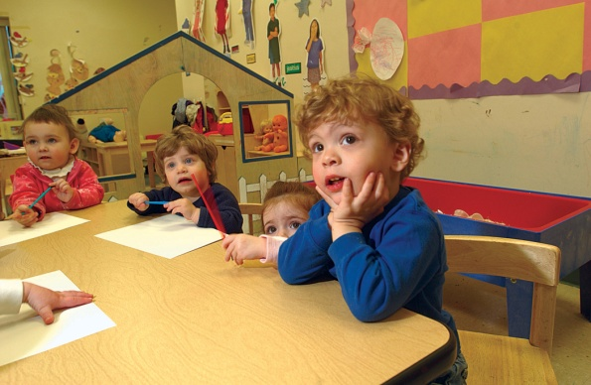
Listening
“Listening is the foundation for all literacy development: Until children are able to listen, they cannot develop vocabulary or build comprehension”
Attention span is a large part of listening skills. Children with disabilities may need to listen for vital cues in order to understand what is happening.
On the flip side children with hearing loss may need to use residual hearing abilities to listen to what is being said.
Think about the child you researched-how would that particular disability effect a child’s ability to develop strong listening skills?
Adapted from Inclusive Literacy L:Essons for Early Childhood by Pam Schiller and Clarissa Willis

Slide 41
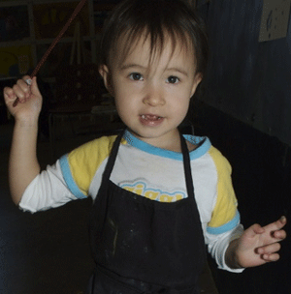
Oral Language Development
“Oral Language development is the next building block in the foundation of literacy. Components of Oral language include vocabulary and accurate grammar with the
ultimate goal of fluent speech”
Children acquire 60% of their lifetime vocabulary by age 5.
Also it is natural to use more vocabulary with children who seem more articulate. Imagine the impact this has on children with speech and language delays-ironically because of these delays they often do not have the same opportunities as peers to increase their language skills.
The more vocabulary a child has the greater their ability to fully understand the plot and details of a story.
Adapted from Inclusive Literacy L:Essons for Early Childhood by Pam Schiller and Clarissa Willis

Slide 42
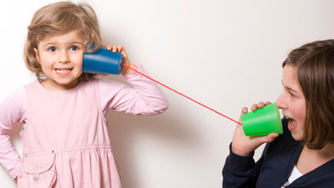
Oral Language (cont.)
Modeling sentence structure helps children to hear the correct use of grammar and modify their own use of grammar.
Children with cognitive or severe language delays have difficulty learning from modeling they need direct instruction on how to use language and extra practice.
Breaking new information or instructions into smaller pieces and practicing each step with the child is essential
Vocabulary and grammar play an important role in a child’s ability to comprehend.
Adapted from Inclusive Literacy L:Essons for Early Childhood by Pam Schiller and Clarissa Willis

Slide 43

Phonological awareness
Phonological awareness is sensitivity to sounds. Activities include recognizing same and different sounds, playing with onomatopoeic words, matching rhyming words pairs, and identifying the repetitive sound in alliterative phrase or sentence. `
The foundation for sound discrimination is wired into the brain during the first year of life-the brain is capable of wiring sounds of the man y different languages it experiences.
Children with disabilities do not develop awareness of the sounds they hear. Because of this children who are deaf need to learn how to use words in context as opposed to sounding thing out. Children with language delays need extra practice toe develop phonological awareness. Children with cognitive deficits need too have tasks broken down into small steps and need extra time to practice each step to help build the skills necessary for phonological awareness.
Adapted from Inclusive Literacy L:Essons for Early Childhood by Pam Schiller and Clarissa Willis

Slide 44
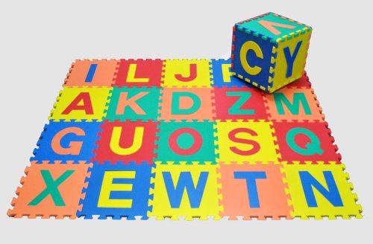
Letter knowledge and Recognition
Letter knowledge and recognition is the ability to recognize all 26 letters of the alphabet in both uppercase and lowercase form and to understand that letters are the foundation of words.
IT is important to teach the alphabet in a way that is flexible and moveable. Children with disabilities often do not generalize. They need to see letters as different components.
To help children see letters as independent components
sing the alphabet forward and backwards
Have the children sort letters by the type of line used to make the letters.
Children with visual impairments need to understand what letters in other ways such as touching letter cutouts.
Children with disabilities learn new concepts in context. It is important to teach letters in the context of real life such as learning the letters of your name.
Adapted from Inclusive Literacy L:Essons for Early Childhood by Pam Schiller and Clarissa Willis

Slide 45
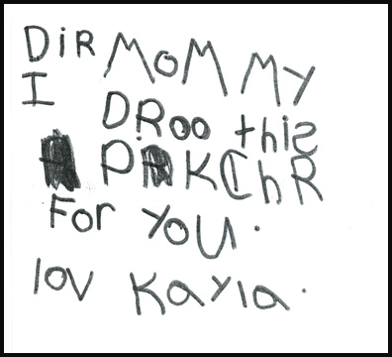
Print Awareness
Print awareness is the knowledge that printed words move from left to right and from top to bottom. Awareness that print has many functions-labeling items, creating lists, and conveying information in newspapers, telling stories in books, identifying exits and entrances etc.
Research has shown that children with disabilities needs more visual cues (pictures) to help them learn to recognize print in the environment
Children with disabilities need additional opportunities to practice print awareness and multiple opportunities to practice what they learn in a variety of settings.
Adapted from Inclusive Literacy L:Essons for Early Childhood by Pam Schiller and Clarissa Willis

Slide 46
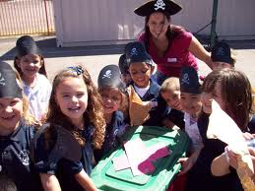
Comprehension
Comprehension is the internalization of a story. Children develop this skill when they retell stories in their own words, act out stories, and listen to stories that are not accompanied by illustrations. It is through comprehension skills that children are able to make stories of their own.
Children with disabilities may not have the same internalization skills as their peers. It is important to help them involve themselves in the storyline.
Children with short attention spans often have difficulty developing critical listening skills.
Children with limited language repertoire needs explicit instructions and multiple opportunities to understand what words mean and how they are used in context.
Children with vision impairments or hearing loss need specialized instruction, they need activities adapted in a way they can understand.
Adapted from Inclusive Literacy L:Essons for Early Childhood by Pam Schiller and Clarissa Willis

Slide 47

BREAK: Please enjoy your lunch!
When you return from lunch you will meet in small groups and design a presentation based on the disability you chose to research.
Please return in thirty minutes to allow us time to complete
Session 4: Including Children with Disabilities in Early Education and Care Settings.

Slide 48

Session 4
Including Children with Disabilities
in
Early Education and Care Settings

Slide 49
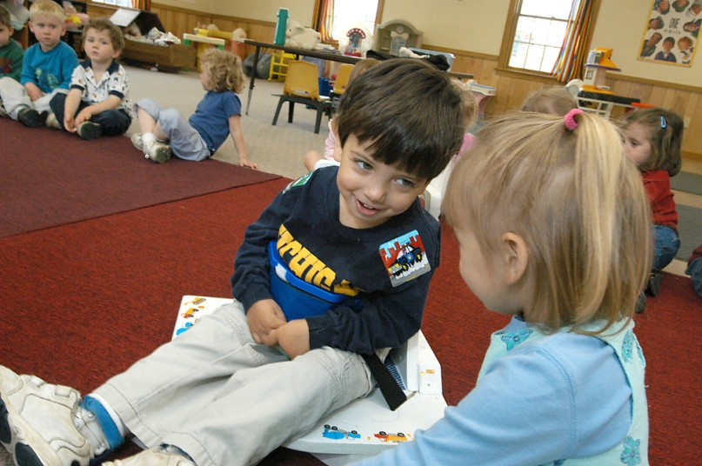
Including Samuel
This is a wonderful film that tells the story of a family as they struggle to accept and support their child. Please look at the viewing guide to help you become meaningfully engaged in this film. If there is time we will have a brief discussion following the film.

Slide 50
Questions and Evaluations
Thank you for your participation in this course! You will need to complete the following in order to receive your CEU:
Turn in your homework
Complete course evaluation
Complete EEC course evaluation
Settle paperwork and business with Linda Zucko

